Slide 1
(Short) Introduction to Machine Learning
Alberto TONDA, Senior Researcher (DR)
UMR 518 MIA-PS (Applied Mathematics and Computer Science) INRAE, AgroParisTech, Université Paris-Saclay Institut des Systèmes Complexes, Paris-Ile-de-France

Slide 2

Outline
What is machine learning
ML as optimization
Supervised ML
Overfitting
Unsupervised ML
Issues

Slide 3
Machine learning (more proper definition)
Given a class of tasks T, a performance measure P, and experience E, a machine learning algorithm improves its performance measured with P, for tasks in T, using the experience E

Slide 4
Machine learning (more proper definition)
Given a class of tasks T, a performance measure P, and experience E, a machine learning algorithm improves its performance measured with P, for tasks in T, using the experience E

Slide 5
Machine learning as optimization
Learn a task directly from examples
No need for symbols, just large quantities of data
Samples (rows) and features (columns)
“Dirty secret” of ML: it’s mostly optimization
Restate learning task as optimization task
Solve it relying on available (training) data
Learning Task
Optimization Task

Slide 6
Machine learning as optimization
What does “restating” the problem mean?
Variables to optimize: parameters of the model
Create an objective function related to your learning problem
Optimizing the objective function also solves your problem
Types of machine learning
Supervised: we have labeled data (correct answers, ground truth)
Common tasks: classification, regression
Unsupervised: we do not have labeled data
Common tasks: clustering, dimensionality reduction; also the base of advanced techniques, such as image/text generation

Slide 7
Vocabulary
Model/predictor: one candidate solution (regressor/classifier)
Model parameters
Values (numerical, categorical, …) inside the model
Optimized (e.g. change values) during training process
Samples: rows of the dataset
Features: columns of the dataset
Training data: data from which we want to learn
Test data: unseen data, kept aside to assess generalization
Validation data: used during training, not for training (!)
Training/Fit: optimize parameter values to fit training data

Slide 8
Vocabulary
Model hyperparameters
Choices/parameters outside the model
Usually user-defined before training process starts
Capacity (loose definition)
Maximum order of function that can be approximated by model
The more parameters, the more capacity
Bias: source of errors, not enough capacity (underfitting)
Variance: sensitivity to small variations in training data, too much capacity (overfitting)

Slide 9

Supervised machine learning
How would you construct our objective function for ML?

Slide 10
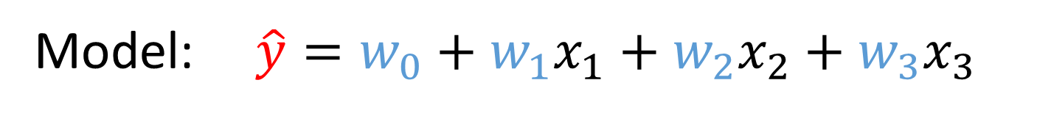
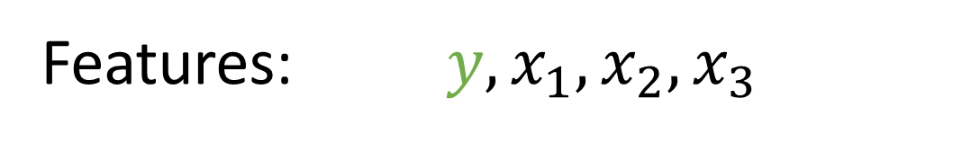
Supervised machine learning
Regression
Minimize (squared/abs) difference predictions - training data
Way of optimizing depends on the structure of the model
After optimization, R2/MSE is usually used as a metric of quality
Features: $y, x_{1},x_{2},x_{3}$
Model: $\hat{y}=w_{0}+w_{1}x_{1}+w_{2}x_{2}+w_{3}x_{3}$
Optimization task: $argmin(\sum_{i=0}^{N}{| \hat{y}(i) −y(i) |)}$

Slide 11
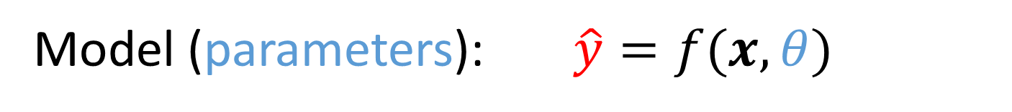
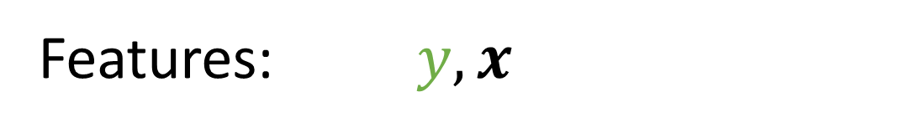
Supervised machine learning
Regression
Minimize (squared/abs) difference predictions - training data
Way of optimizing depends on the structure of the model
After optimization, R2/MSE is usually used as a metric of quality
Features: $y, x$
Model (parameters): $\hat{y}=f(x, θ)$
Optimization task: $argmin(\sum_{i=0}^{N}{| \hat{y}(i) −y(i) |)}$

Slide 12
Supervised machine learning
Regression
Minimize (squared/abs) difference predictions - training data
Way of optimizing depends on the structure of the model
After optimization, R2/MSE is usually used as a metric of quality
Sometimes called “problem variables” in ML
Features: $y, x$
Model (parameters): $\hat{y}=f(x, θ)$
Optimization task: $argmin(\sum_{i=0}^{N}{| \hat{y}(i) −y(i) |)}$
From an optimization point of view, these are variables!

Slide 13
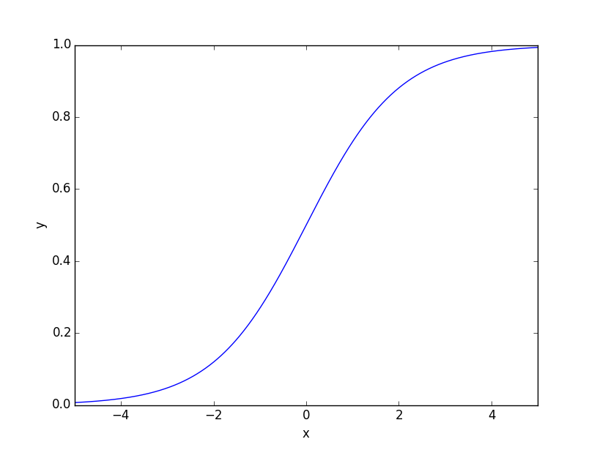
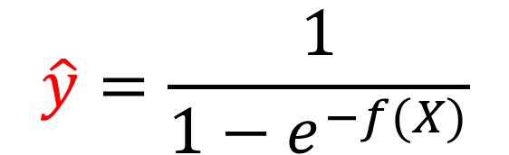
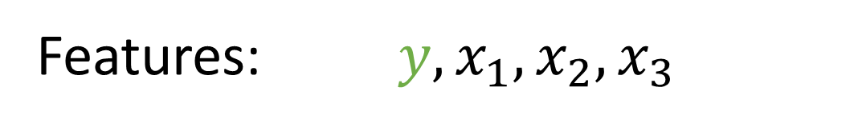
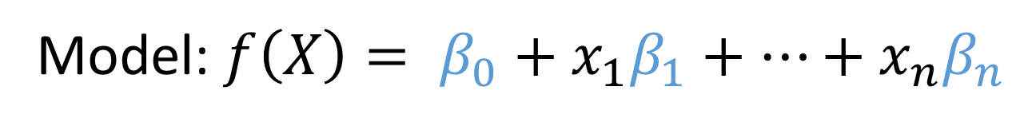
Supervised machine learning
Classification
During training, sometimes treated as continuous optimization
E.g. interpret continuous output as probability of class (not only)
Features: $y, x_{1},x_{2},x_{3}$
Model: $f\left(X\right)= β_{0}+x_{1}β_{1}+…+x_{n}β_{n}$
$$\hat{y}=\frac{1}{1−e^{−f(X)}}$$

Slide 14
Supervised machine learning
Classification
Evaluating a trained model: accuracy, % of correct answers
F1, Matthew’s Correlation Coefficient, AUC ROC are better
Features: $y, x_{1},x_{2},x_{3}$
Model: $f\left(X\right)= β_{0}+x_{1}β_{1}+…+x_{n}β_{n}$
$$\hat{y}=\frac{1}{1−e^{−f(X)}}$$

Slide 15

Overfitting and regularization
ML model has been trained on data
It fits the training data really well
It DOES NOT generalize for unseen data
The trained model captures unique properties of the training data…
…that only exist for those data samples
How can we evaluate overfitting?
Image generated by AI, prompt “The concept of overfitting in machine learning as the final boss monster in a videogame”

Slide 16

Overfitting and regularization
Hide part of the available data, use it only for test
Ok, but we could be just lucky! We can do better
k-fold cross-validation (k=5 or 10)
Divide data into k parts (splits)
Iterate k times
Each time, use k-1 splits for training
One split for testing
Obtain an average and a stdev of performance
Large stdev usually indicates issues

Slide 17
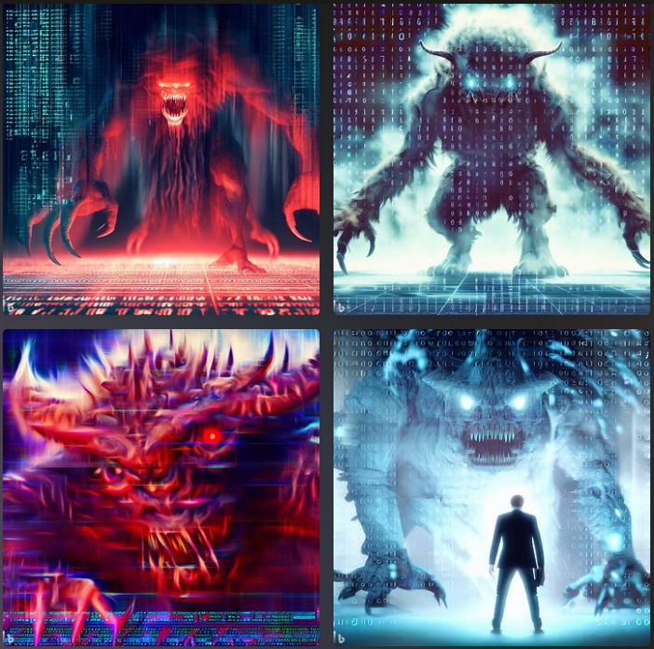
Overfitting and regularization
Optimizing for maximal fitting is not enough
Also need to add penalties for overfitting
But how?
Penalize values correlated to overfitting
In Genetic Programming, tree size
Linear Models, coefficient values
Artificial Neural Networks, weight values

Slide 18

Unsupervised machine learning
There is no ground truth, no labels; what can we optimize?

Slide 19
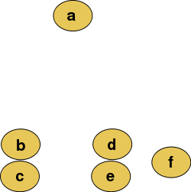
Clustering
Group together points (samples) in feature space
On the basis of their (Euclidean) distance (or other measure)
Show the user different groups (dendrogram), ask them to pick

Slide 20
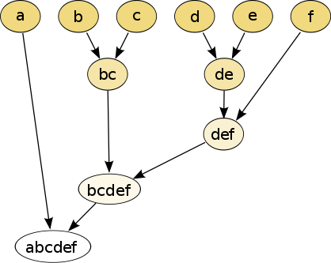
Clustering
Group together points (samples) in feature space
On the basis of their (Euclidean) distance (or other measure)
Show the user different groups (dendrogram), ask them to pick

Slide 21
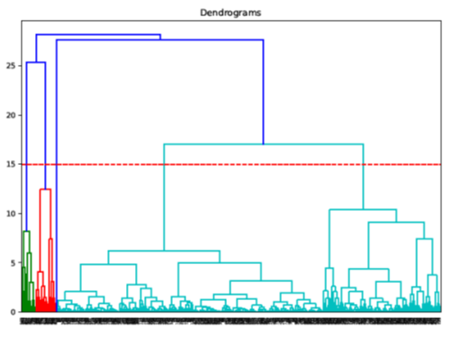
Clustering
Group together points (samples) in feature space
On the basis of their (Euclidean) distance (or other measure)
Show the user different groups (dendrogram), ask them to pick

Slide 22
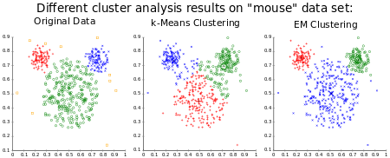
Clustering
Other solutions: min inter-cluster distance, max intra-cluster
State-of-the-art algorithms
Hierarchical agglomerative clustering
Density-Based Spatial Clustering of Applications with Noise (DBSCAN)
Hierarchical DBSCAN
Visualize results!!!
However, datasets are high-dimensional!

Slide 23
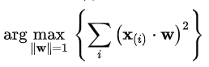
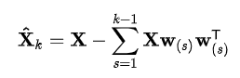
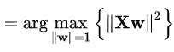
Dimensionality reduction
Principal component analysis
Transform a higher-dimensional feature space in lower dimension
Each new dimension explains a part of the original variance
New dimensions are weighted sums of the original features
Can be framed as a maximization problem
Other technique: t-SNE (t-distributed Stochastic Neighbor Embedding)

Slide 24
Embeddings
Create vector space, distances/positions have meaning
Automatically, starting from data
We don’t know exactly how the space should be
Optimization algorithms used vary depending on case study
Often heuristics, but sometimes gradient descent on NNs
Example: Word2Vec

Slide 25
Word2Vec
ML always had issues with language
ML generally works well with continuous values, or sortables
Words are discrete, and their sequence matters
There is a syntax, but also a semantic
In general, this was more the domain of Symbolic AI
But few things worked! Until…
Word2Vec is an unsupervised algorithm
Turns words into points in a (high-dimensional) vector space
Distances and displacements have meaning!

Slide 26
Word2Vec
Input: a considerable amount of text
Output: vector space, each word corresponds to a point
Slides a window over the text
Reduces the distance between middle word and adjacents
Slides the window by one word, iterates
This is a sentence that the algorithm is analyzing…
Reduce distance between points corresponding to “sentence” and “a”, “sentence” and “is”, …

Slide 27
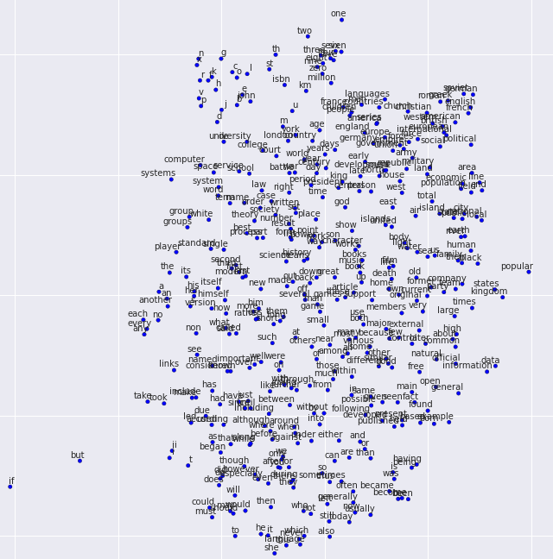
Word2Vec
Vector space

Slide 28
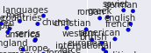
Word2Vec
“French”, “British”, “American”…
Adjectives for nationality!
Nearby, you have “languages”, “countries”
Also, “England”, “Europe”, “International”, …

Slide 29
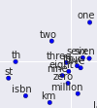
Word2Vec
“one”, “two”, “zero”, “seven”, “million”…
Numbers, quantities
Nearby, you have some units of measurement
Also “th”, and “st”, as in 9-th, 1-st
ISBN (guess usually appears nearby numbers!)

Slide 30
Word2Vec
What is happening here?
Algorithm has no semantic info (no meaning)
But words with similar meaning are close
Just by looking at the position of words in text
Words with similar use appear in same positions with respect to other words
Word2Vec captures some aspects of meaning
Can we do something else with Word2Vec?

Slide 31
Word2Vec
Can we do something else with Word2Vec?
“Woman”
WOMAN - MAN
TRANSFORMATION THAT CAN BE COMPUTED
“Man”

Slide 32
Word2Vec
Can we do something else with Word2Vec?
“Queen”
“Woman”
WOMAN – MAN + KING = QUEEN
“King”
MASCULINE -> FEMININE
“Man”

Slide 33
Word2Vec
DOG : PUPPY = CAT : ???
PUPPY - DOG
“Puppy”
“Kitten”
“Dog”
“Cat”
Notes:
What do you expect to see here?

Slide 34

Word2Vec
Notes:
He is the granpa of ChatGPT

Slide 35
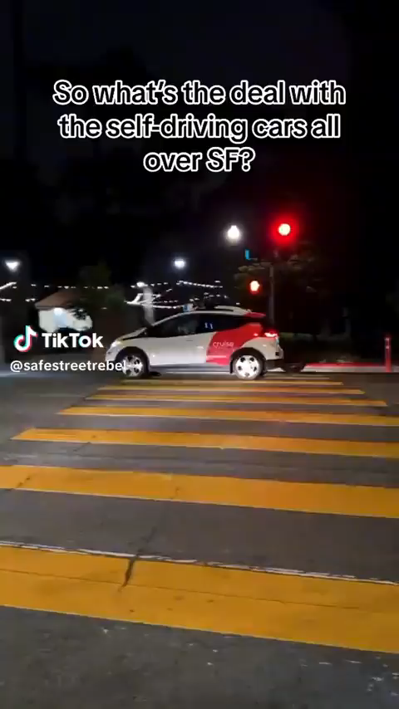
Practical issues with machine learning
Algorithms find correlations, not causal relationships
Black-box effect
Fragility (combination of inputs that unexpectedly produce undesired results)
All this for large, high-capacity models

Slide 36

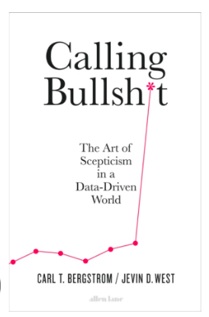


Societal issues with machine learning
Ethical implications
Bias in the data
Black-box effect
Unintended consequences
Further reading (divulgation)
https://callingbullshit.org/
Weapons of Math Destruction
The Age of Surveillance Capitalism
Toxic Data

Slide 37
Practical advice (July 2023)
Supervised ML
Try all the algorithms with default values, pick the best
Or run “AutoML” approaches (next set of slides)
If you do not have the time to do that
For images: a convolutional neural network (CNN)
For text: transformer neural networks (or Word2Vec)
For tabular data: XGBoost, LightGBM, or Random Forest
For time series: …nothing really works better than other systems

Slide 38
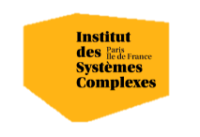

Questions?
Bibliography - James et al., An Introduction to Statistical Learning with Applications in Python, 2023
Images and videos: unless otherwise stated, I stole them from the Internet. I hope they are not copyrighted, or that their use falls under the Fair Use clause, and if not, I am sorry. Please don’t sue me.

